Slide 1
House Sale Price Prediction
Vikash Kumar singh

Slide 2
Problem Statement And Understanding
Houses are one of the necessary need of each and every person around the globe and therefore housing and real estate market is one of the markets which is one of the major contributors in the world’s economy. It is a very large market and there are various companies working in the domain. Data science comes as a very important tool to solve problems in the domain to help the companies increase their overall revenue, profits, improving their marketing strategies and focusing on changing trends in house sales and purchases. Predictive modelling, Market mix modelling, recommendation systems are some of the machine learning techniques used for achieving the business goals for housing companies. Our problem is related to one such housing company
A US-based housing company named Surprise Housing has decided to enter the Australian market. The company uses data analytics to purchase houses at a price below their actual values and flip them on at a higher price. For the same purpose, the company has collected a data set from the sale of houses in Australia. The data is provided in the CSV file below.
The company is looking at prospective properties to buy to enter the market. You are required to build a regression model using regularization in order to predict the actual value of the prospective properties and decide whether to invest in them or not.

Slide 3
In general, any machine learning problem can be assigned to one of two broad classifications: Supervised learning and Unsupervised learning.
Supervised Learning: - In supervised learning ,we are given a data set and already know what our correct output should look like, having the idea that there is a relationship between the input and the output. Supervised learning problems are categorized into “regression” and “classification” problems.
In a regression problem, we are trying to predict results within a continuous output, meaning that we are trying to map input variables to some continuous function.
In a classification problem, we are instead trying to predict results in a discrete output. In other words, we are trying to map input variables into discrete categories.
Unsupervised Learning: -Unsupervised learning allows us to approach problems with little or no idea what our results should look like .We can derive structure from data where we don’t necessarily know the effect of the variables. We can derive this structure by clustering the data based on relationships among the variables in the data. With unsupervised learning there is no feedback based on the prediction results.

Slide 4
EDA steps and visualizations :
Cleansing the dataset:
This is an essential step to perform before creating a visualization. Clean, consistent data will be much easier to visualize.
Data cleaning tasks will be very dependent on the dataset that you’re working with. In most cases, data cleaning involves:
Removing unnecessary variables
Deleting duplicate rows/observations
Addressing outliers or invalid data
Dealing with missing values
Standardizing or categorizing values
Correcting typographical errors

Slide 5
Data Visualization:
The data preparation steps involve various type of visualization, which include:
bar plot to check the relationship between categorical and numerical variables.
Scatter plot is used to check the relationship between two variables.
Distplot is used to check the distribution of any variable. A well distributed variable shows bell shape curve. It also analyze the skewness of the variables.
Box plot is to determine the outlier of variables.
Heat map shows for the multicollinearity between variables.
Pair plot is used to create an axis grid for every numerical variable.

Slide 6
Steps and assumptions used to complete the project:
Importing train and test data set
train data info
Checking Null Values in train dataset
checking null values in test dataset
combining train and test dataset
cleansing the dataset
fill categorical missing values
fill numerical missing values
transforming the target data
feature transformations
Transforming the skewed data by Log Transformation
distribution of numerical features
removing the outliers
Pair plot
Heatmap of numerical variables
scaling the dataset
splitting the train and test dataset
concating the features and target
splitting the target and features
Train_test_split
Metrics-explained variance, mean absolute error, mean squared error ,r2 score, adjusted r2 score
Accuracy; cross validation score with cv=5
Standard deviation
Models

Slide 7
Models:
Names:
Linear regression
Random forest regressor
Decision tree regressor
Support vector regressor(SVR)
Kneighbour regressor
XGB regressor
Lasso regressor
Ridge regressor
Adaboost regressor
Gradient boosting regressor
Accuracy:
-42…%
87.02%
72.30%
-5.4%
72.23%
86.67%
84.13%
84.92%
83.51%
88.75%

Slide 8
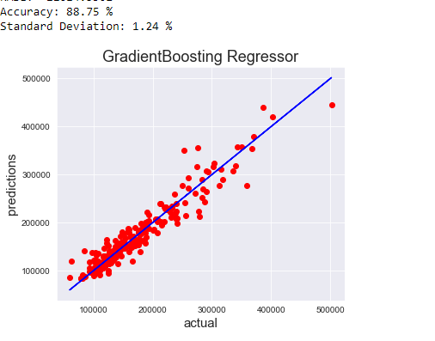
Finalized model:
Model 10; Gradient boosting regressor has highest accuracy and lowest standard deviation

Slide 9
Conclusion:
The main aim of this project was to determine the prediction of sale price. In this project, we have discovered many algorithms and application of machine learning techniques with the objective to predict the sale price of houses. Price can be predicted through many factors like the Electricity, water availability and many related factors with the house. We have first cleaned and exploring of the input data. We have performed Linear regression, Random Forest regressor, Decision Tree regressor, SVR, KNeighbours regressor, Lasso, Ridge, Adaboost regressor, XGB regressor and Gradient boosting regressor. In all the above models, Gradient boosting regressor have performed with highest accuracy. We also have performed hyper para meter tuning (grid search cv) but the outcome remains same.

Slide 10
THANK YOU

